Slide 1
Glands
There are two types of glands in the body:
Exocrine Glands or “outside glands” release chemicals into a duct/tube/cavity or to the outside of the body.
Examples are: sweat glands, sebaceous (oil) glands, salivary glands, gastric glands, lachrymal (tear) gland.
Endocrine Glands also called “Ductless Glands” release their chemicals called hormones directly into the blood stream. The list of endocrine glands follows.

Slide 2
Glands
There are two types of glands in the body:
Exocrine Glands or “outside glands” release chemicals into a duct/tube/cavity or to the outside of the body.
Examples are: sweat glands, sebaceous (oil) glands, salivary glands, gastric glands, lachrymal (tear) gland.
Endocrine glands also called “Ductless Glands” release their chemicals called hormones directly into the blood stream. The list of endocrine glands follows.

Slide 3
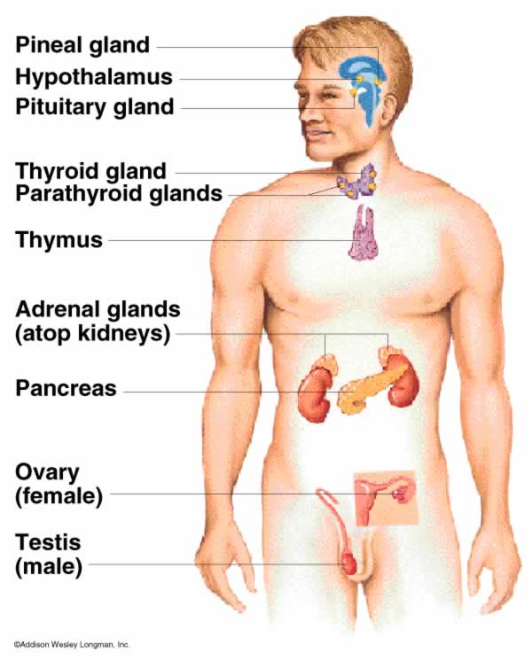
Endocrine Glands

Slide 4
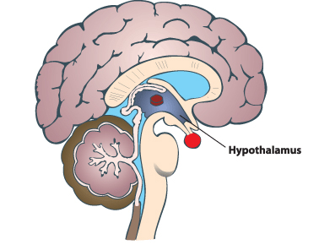
Hypothalamus
Connects the brain to the endocrine system. Produces releasing factors

Slide 5
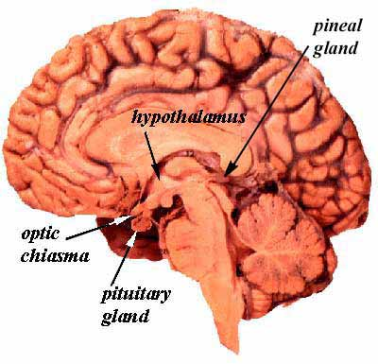
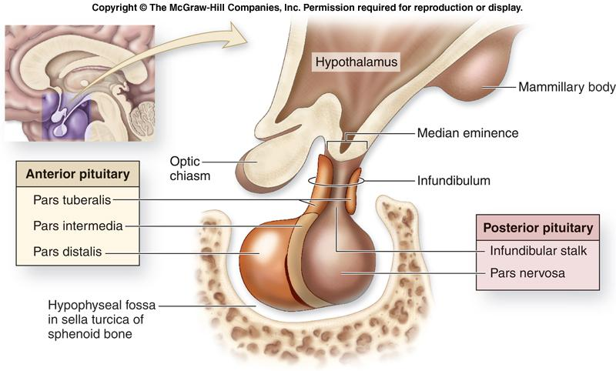
Pituitary Gland
Master gland of the body releases hormones that control all the other glands

Slide 6
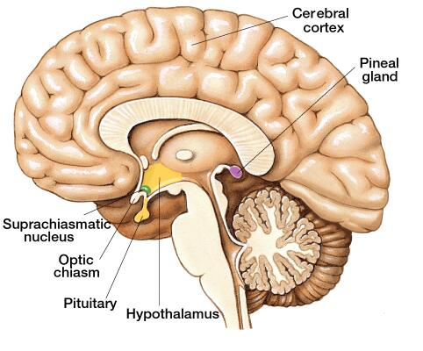
Pineal Gland
Connected to optic nerve releases melatonin related to the amount of light the eyes see.
Melatonin control body rhythms and wake/sleep cycles.

Slide 7
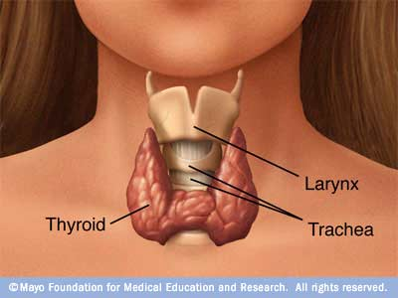
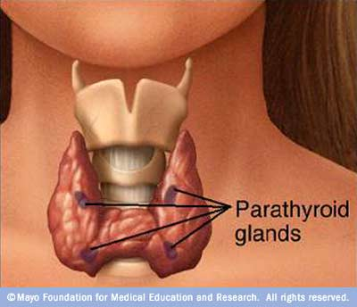
Thyroid Gland
This glands controls your metabolism by releasing the hormone Thyroxin that speeds up the conversion of food to energy.
Parathyroid Glands – Four small glands inside the thyroid that release parathormone that controls calcium levels in the blood.

Slide 8
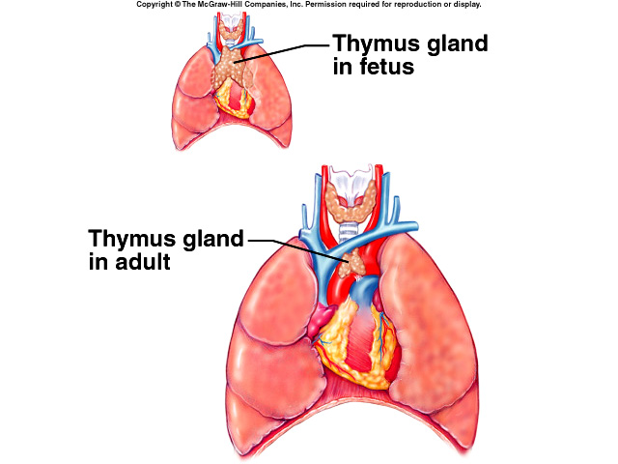
Thymus Gland
This gland is involved with the immune system and produces Thymus (T) Lymphocytes or T – cells. Its activity begins to slow down in your late teens. Much bigger and more active when your are young.

Slide 9
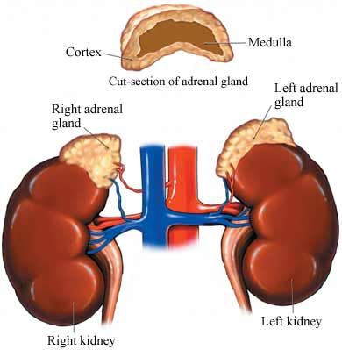
Adrenal Glands
This glands produce adrenalin and cortisone. Adrenalin helps get you through stressful times and produces the “fight or flight” response. Cortisone helps healing and reduces pain.

Slide 10
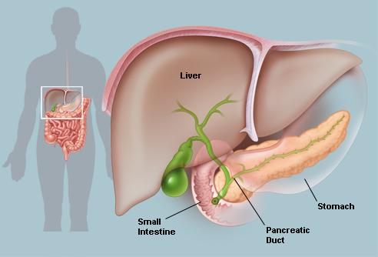
Pancreas
This is known as a mixed gland doing exocrine and endocrine function. The exocrine function is to release enzymes and buffers into the digestive system. The endocrine function is making insulin to control sugar levels in the blood.
Hyperglycemia to much sugar to little insulin
Hypoglycemia to little sugar to much insulin

Slide 11
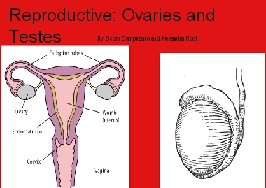
Ovaries and Testes
These are also mixed glands. The exocrine function is to release egg and sperm. The endocrine function is to produce the sex hormones.
Ovaries produce estrogen for sexual development and egg production. Progesterone prepares the body for pregnancy
Testes produce testosterone for sexual development and sperm production.

Slide 12
There are two types of hormones
Steroid Hormones these are small molecules that can affect every tissue in the body.
ex: Estrogen & Testosterone
Protein Hormones are large molecules and can only affect cells that have the proper receptors for the hormone to attach to.
This tissue is called Target Tissue
ex: Glucagon Liver

Slide 13
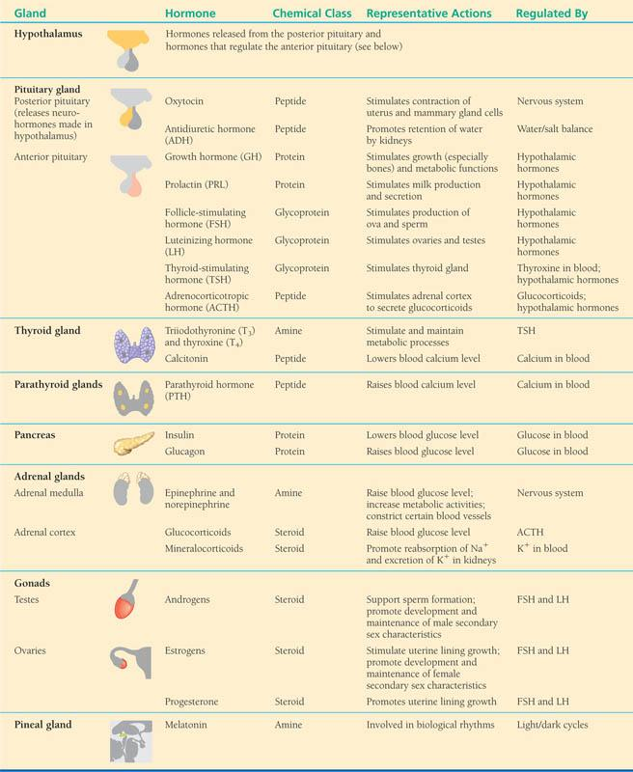

Slide 14
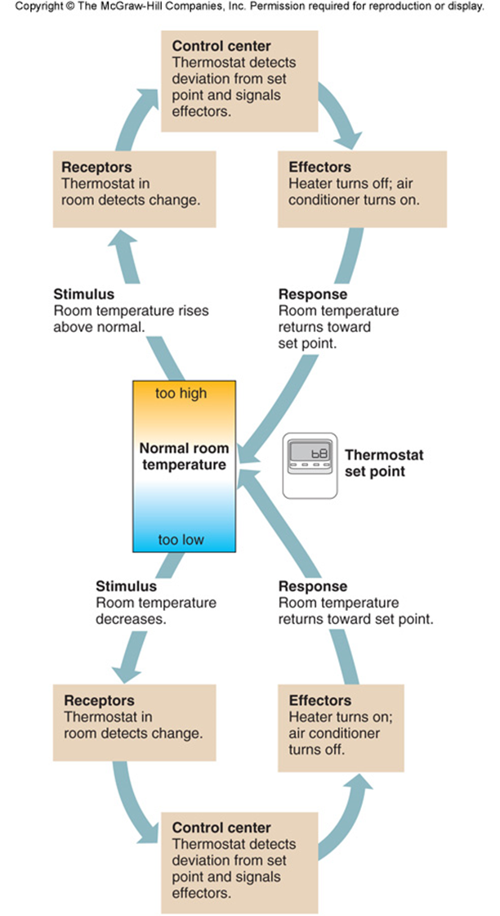
Feedback Mechanism
Turning body systems on and off to maintain homeostasis.
Positive Feedback turns things ON
Negative Feedback turns things OFF

Slide 15
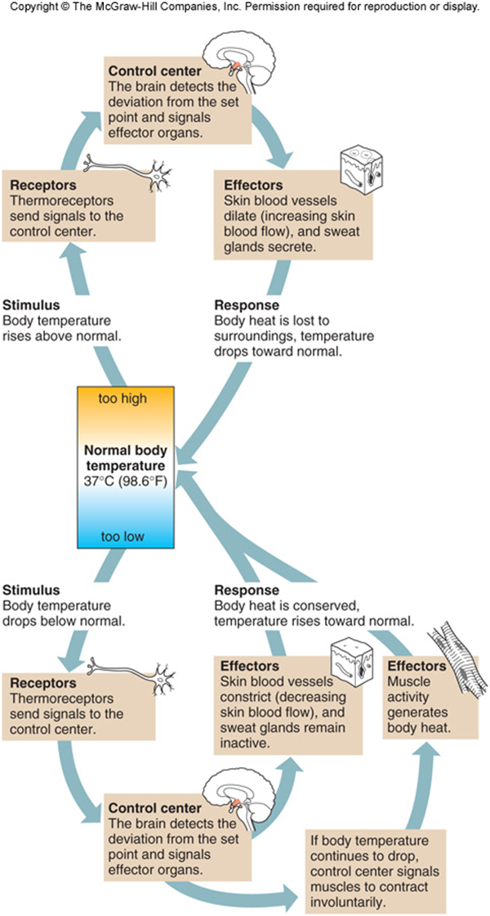
Feedback to control body temperature.

Slide 16
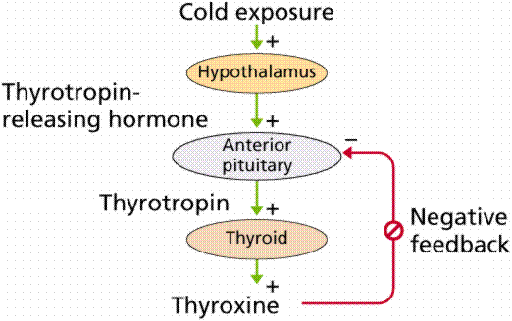
Feedback
Positive Feedback

Slide 17
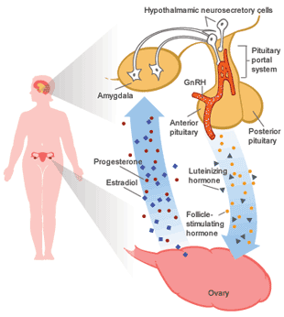
Feedback
For Reproduction.
Negative
Turns system OFF
Positive
Turns system ON
Egg is ovulated

