Slide 1
Confirmation Bias
We actively try to support what we already believe rather than trying to find out where we might be wrong. We seek out information that confirms our view. We interpret ambiguous or mixed information to confirm our existing theories (e.g., Darley & Gross, 1983).
This confirmation bias is one of the many natural inclinations we have in our thinking and decision-making.
DevPsy.org
Notes:
We actively try to support what we already believe rather than trying to find out where we might be wrong. We seek out information that confirms our view. We interpret ambiguous or mixed information to confirm our existing theories (e.g., Darley & Gross, 1983).
This confirmation bias is one of the many natural inclinations we have in our thinking and decision making.

Slide 2
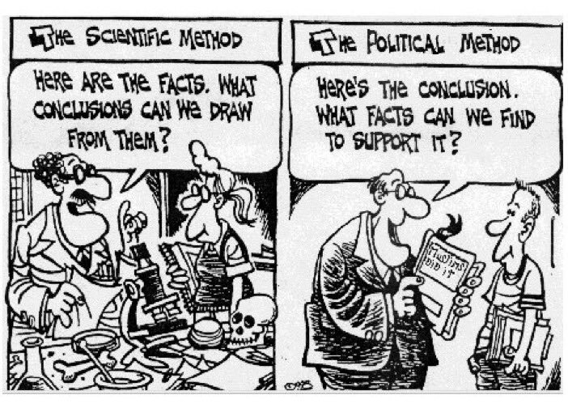
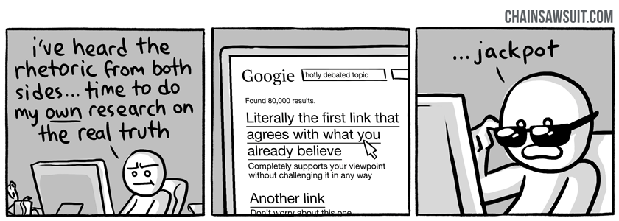
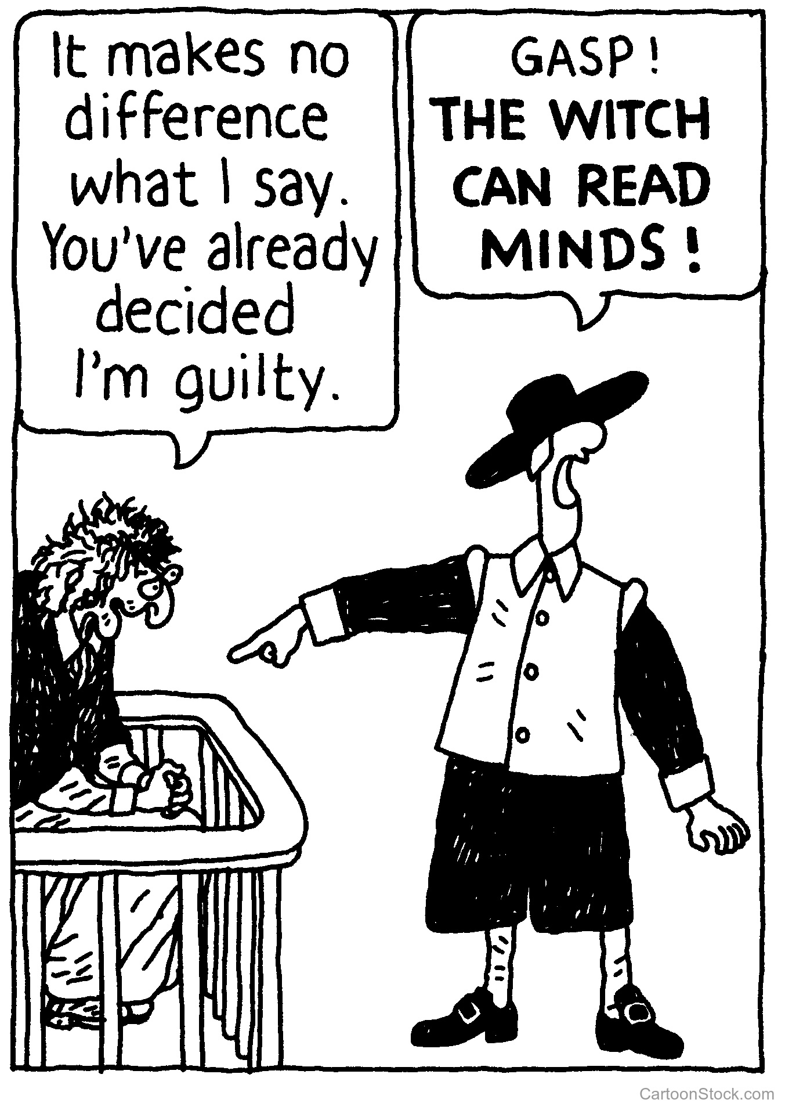
Confirmation Bias in Everyday Life
DevPsy.org
Notes:
Is the confirmation bias merely a neat trick we can use to fool people in a little game? Or is it more broadly applicable to everyday life? Examples?
The examples students might generate are seemingly endless. Some examples include:
* the appeal of Fox News and MSNBC, whose viewers are mostly those who already agree with their political leanings
* when we search online, we seek information we already agree with or we seek to connect with those we agree with (e.g., social media)
* once we stereotype a group of people, we interpret their actions and circumstances to fit the stereotype (e.g., why are poor people poor)
* once we have a reputation (e.g., clumsy, smart) people interpret our actions as fitting their preconception

Slide 10
Hindsight Bias
the tendency of people to overestimate their ability to have predicted an outcome that could not possibly have been predicted.
Saying "I knew it!" when an outcome (either expected or unexpected) occurs - and the belief that one actually predicted it correctly.

Slide 11
A letter comes in the mail informing an student that he was accepted into a college. When he tells his mother she says, "I really had a feeling that you were going to get in" (even though she had expressed doubts to his father earlier that week).
You are nervous to take an exam for which you waited to study until the very last minute. When you take the exam, you feel unsure about the results; however, when your grade comes back with an “A” you exclaim to your friends, "I was sure that I'd aced that exam!" and actually believe it in hindsight.
Some of you may have experienced the “I knew it!” effect when practicing the standard deviation quiz.

Slide 12
Overconfidence Bias & False Consensus Effect
Election Night 2016
Overconfidence Bias
The tendency to be confident than correct
To overestimate the accuracy of one’s judgements.
False Consensus effect
people tend to overestimate the extent to which their opinions, beliefs, preferences, values, and habits are normal and typical of those of others

