Slide 1
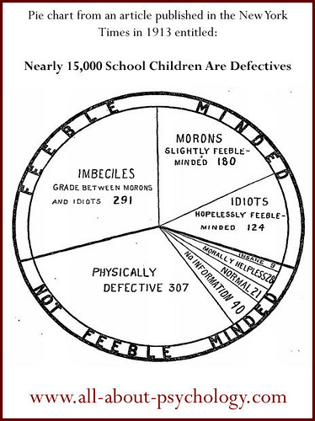
Introduction to Intelligence
General intelligence
Multiple Intelligences
Triarchic Theory
Emotional intelligence

Slide 2
Alfred Binet
Alfred Binet and his colleague started modern intelligence testing by developing questions that would predict children’s future progress in the Paris school system.

Slide 3
Lewis Terman
Lewis Terman adapted Binet’s test for American school children and named the test the Stanford-Binet Test
He normed the IQ tests but his samples were not representative. Much bias in the early tests.

Slide 4
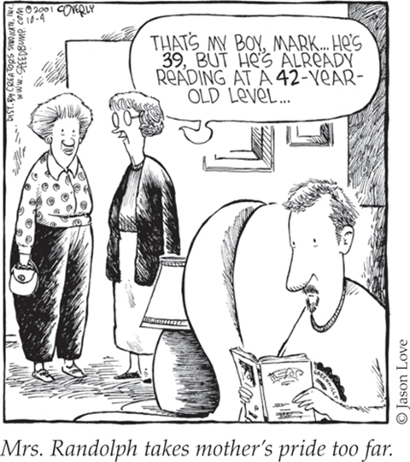
Intelligence Quotient
William Stern introduced the formula of Intelligence Quotient (IQ)
Chronological age of the child and the mental age which corresponds to the difficulty of the questions a child can answer

Slide 5
An average 8-year-old child should have the mental age of 8 years. 8/8=1*100=100 IQ (the mean)
An 8 year old with a mental age of 10 years is 10/8=1.25*100=125 IQ
Imagine a child who is 5 years old and had an IQ of 165. What is their mental age?
X/5=1.65*100=165
About 8 years, 3 months
Doesn’t work on adults. A 40 year who has the mental age of 20 shouldn’t have an IQ of 50.

Slide 6
What is Intelligence?
Intelligence (in all cultures) is the ability to learn from experience, solve problems, and use knowledge to adapt to new situations.
Psychologists believe that intelligence is a concept and not a “thing.”
In research studies, intelligence is whatever the intelligence tests measure …
which tends to be school smarts.
Notes:
OBJECTIVE 31-1| Discuss the difficulty of defining intelligence, and explain what it means to “reify intelligence.”.
Despite general agreement among psychologists about the nature of intelligence, there are two controversies that remain:
Is intelligence a single overall ability or several specific abilities?
With modern neuroscience techniques can we locate and measure intelligence within the brain?
Have you ever thought that since people’s mental abilities are too diverse — labeling them with one word intelligence may not be justified?
So you may speculate that diverse abilities may represent different kinds of intelligences. How can you test this idea?
Cattell suggested two different types of intelligences.

Slide 7
General Intelligence
Spearman proposed that general intelligence (g), is linked to many clusters that can be analyzed by factor analysis.
“G FACTOR”
For example, people who do well on vocabulary do well on paragraph comprehension, a cluster that helps define verbal intelligence.

Slide 8
“First a word about “MI theory.” On the basis of research in several disciplines, including the study of how human capacities are represented in the brain, I developed the idea that each of us has a number of relatively independent mental faculties, which can be termed our “multiple intelligences.” The basic idea is simplicity itself. A belief in a single intelligence assumes that we have one central, all-purpose computer—and it determines how well we perform in every sector of life.
In contrast, a belief in multiple intelligences assumes that we have a number of relatively autonomous computers—one that computes linguistic information, another spatial information, another musical information, another information about other people, and so on. I estimate that human beings have 7 to 10 distinct intelligences (see www.multipleintelligencesoasis.org).
-Howard Gardiner

Slide 9
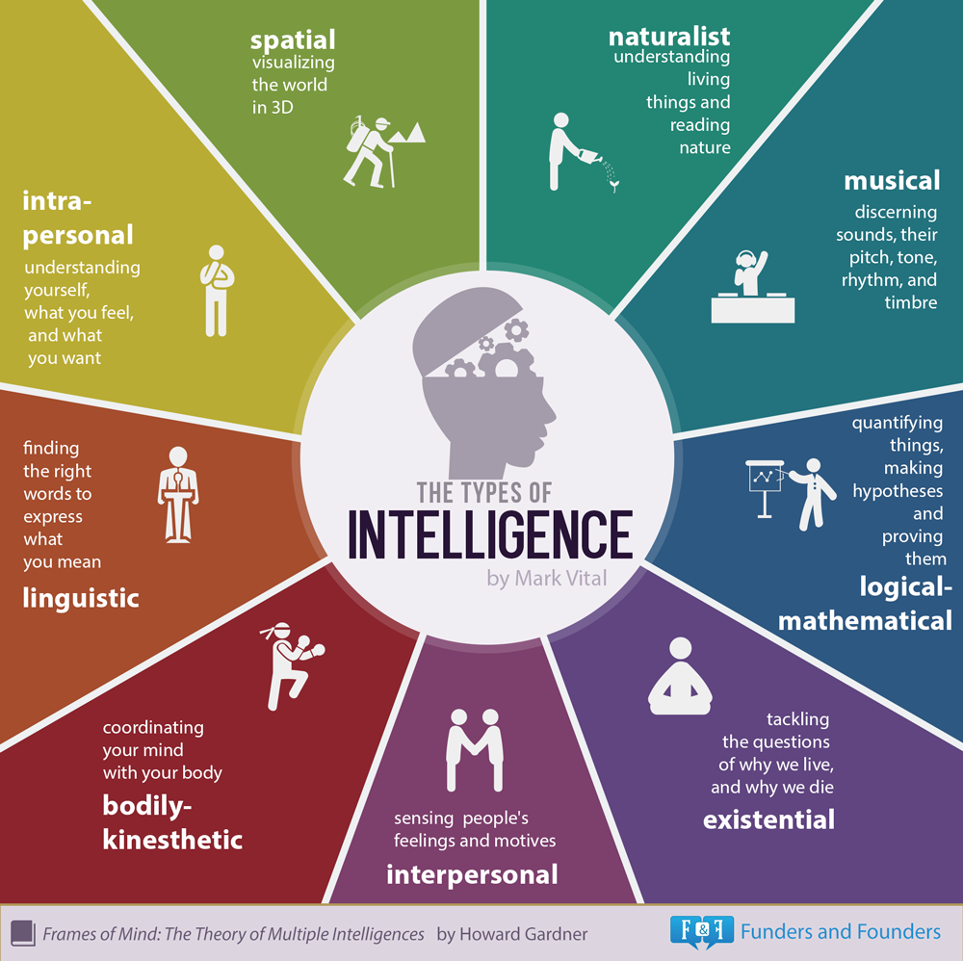
Multiple Intelligences
Gardner proposes nine types of intelligences.

Slide 10
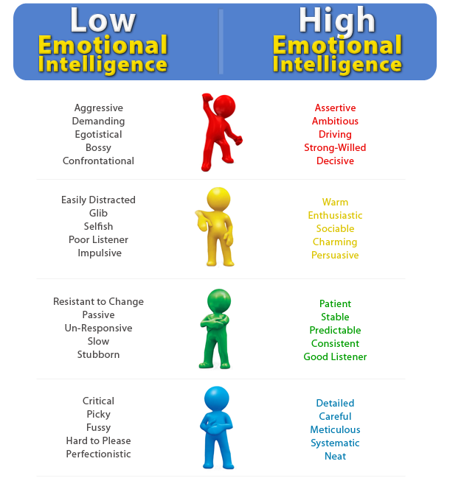
Social Intelligence
Emotional Intelligence is the ability to perceive, understand, manage, and use emotions – interpersonal and intrapersonal skills. (Salovey and colleagues, 2005).
Similar to grit, believed to be a better predictor of success than a traditional IQ.
Notes:
OBJECTIVE 31-4| Describe the four aspects of emotional intelligence, and discuss criticisms of this concept.
EQ test and marshmallow test

Slide 11
Emotional Intelligence: Components
Component | Description
Perceive emotion | Recognize emotions in faces, music and stories
Understand emotion | Predict emotions, how they change and blend
Manage emotion | Express emotions in different situations
Use emotion | Utilize emotions to adapt or be creative

Slide 12
Robert Sternberg
Sternberg (1985, 1999, 2003) also agrees with Gardner, but suggests three intelligences rather than nine. This is the most widely accepted theory of intelligence today.
“Triarchic theory of Intelligence”
Practical Intelligence: Intelligence required for everyday tasks (e.g. street smarts).
Analytical Intelligence: Assessed by intelligence tests.
Creative Intelligence: Intelligence that makes us adapt to novel situations, generating novel ideas.

Slide 13
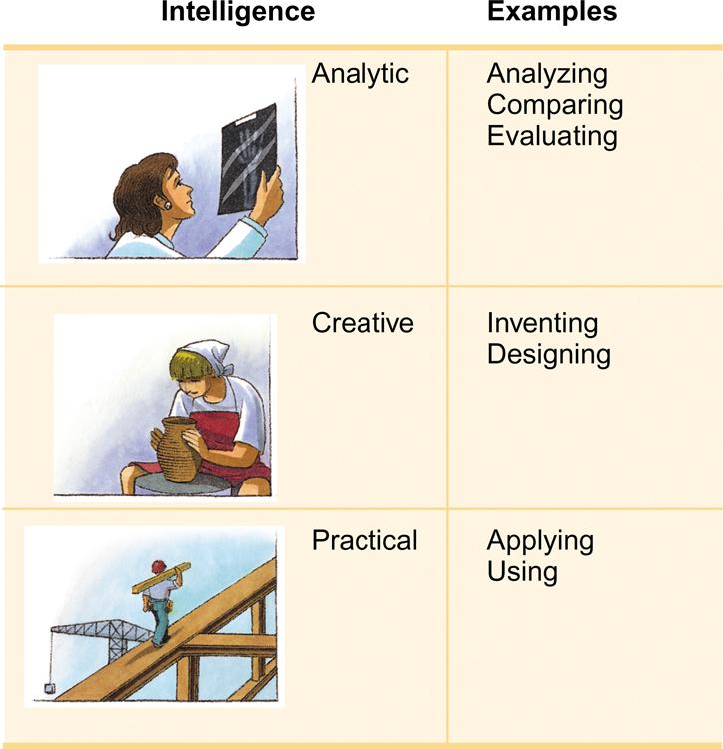
Sternberg’s Types of Intelligence

Slide 14
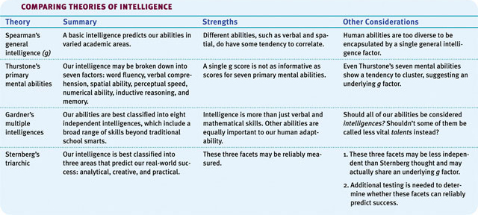
Theories: Comparison

Slide 15
Is Intelligence a Predictor of Success?
College entry, degree program.
Grit more important.
Passion and perseverance of long-term goals.
10-Year Rule – peak after intense practice

Slide 16
Intelligence and Creativity
Creativity is the ability to produce ideas that are both novel and valuable.
Expertise: A well developed knowledge base.
Imaginative Thinking: The ability to see things in novel ways.
Adventuresome Personality: Seeks new experiences rather than following the pack.
Intrinsic Motivation: Motivated to be creative from within.
A Creative Environment: Creativity blooms in creative and supportive environment.
Notes:
OBJECTIVE 31-5| Identify the factors associated with creativity, and describe the relationship between creativity and intelligence.

Slide 17
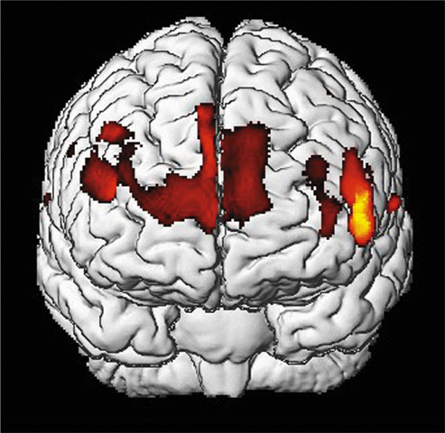
Is Intelligence Neurologically Measurable?
Recent Studies indicate some correlation (+.44) between brain size and intelligence. As brain size decreases with age, scores on verbal intelligence also decrease.
Gray matter concentration in people with high intelligence.
Notes:
OBJECTIVE 31-6| Describe the relationship between intelligence and brain anatomy.

Slide 18
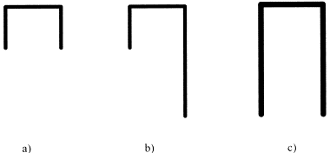
Brain Function
Studies of brain functioning show that people who score high on intelligence tests perceive stimuli faster, retrieve information from memory quickly, and show faster brain response times.
Higher functioning brains are more efficient than others. They use less glucose.
Notes:
OBJECTIVE 31-7| Discuss the findings on the correlations between perceptual speed, neural processing speed, and intelligence.

Slide 19
Assessing Intelligence
-Assessing intelligence
(know the people and the types of tests)
-Achievement vs. Aptitude
-Standardization and the Normal curve
(be able to draw it on the AP EXAM)
-Reliability
-Validity

Slide 20
1. Which number should come next in the pattern?
37, 34, 31, 28
2. Find the answer that best completes the analogy:
Book is to Reading as Fork is to:
a. Drawing b. writing c. stirring d. eating
3. Find two words, one from each group, that are the closest in meaning:
Group A talkative, job, ecstatic Group B angry, wind, loquacious
a. talkative and wind
b. job and angry
c. talkative and loquacious
d. ecstatic and angry
4. Which of the following can be arranged into a 5-letter English word?
a. H R G S T
b. R I L S A
c. T O O M T
d. W Q R G S
5. What number best completes the analogy:
8:4 as 10:
a. 3 b. 7 c.24 d.5
Notes:
25
D
C
B rails and C motto
D 5

Slide 21
Assessing Intelligence
Psychologists define intelligence testing as a method for assessing an individual’s mental aptitudes and comparing them with others using numerical scores.
Notes:
OBJECTIVE 32-1| Define intelligence tests and discuss the history of intelligence testing.
These tests were created to help students, but they have also hurt students because identification for special services can lead to prejudice and discrimination.
Is it better to separate students into ability groups or to have mainstreamed classes? Why?
Are intelligence tests the main way students are identified for services in school? How else can you identify someone who needs special services?
How can intelligence test keep students back? How can they help students succeed?

Slide 22
Alfred Binet
Alfred Binet and his colleague started modern intelligence testing by developing questions that would predict children’s future progress in the Paris school system.

Slide 23
Lewis Terman
Lewis Terman adapted Binet’s test for American school children and named the test the Stanford-Binet Test
He normed the IQ tests but his samples were not representative. Much bias in the early tests.

Slide 24
Intelligence Quotient
William Stern introduced the formula of Intelligence Quotient (IQ)
Chronological age of the child and the mental age which corresponds to the difficulty of the questions a child can answer

Slide 25
An average 8-year-old child should have the mental age of 8 years. 8/8=1*100=100 IQ (the mean)
An 8 year old with a mental age of 10 years is 10/8=1.25*100=125 IQ
Imagine a child who is 5 years old and had an IQ of 165. What is their mental age?
X/5=1.65*100=165
About 8 years, 3 months
Doesn’t work on adults. A 40 year who has the mental age of 20 shouldn’t have an IQ of 50.

Slide 26
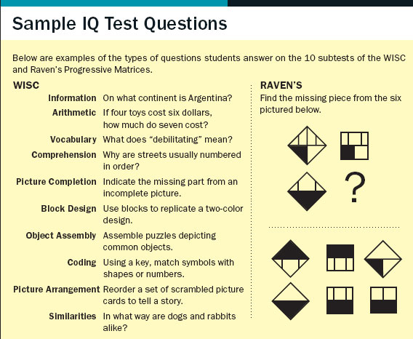
Basics of Intelligence Test Components
Short term memory
Can you replicate this model?
Long term memory
Vocabulary is a good indicator
Association
A cat is to feline as a dog is to ….
Evaluation
If you could have any one tool on an island, what would it be
Reasoning
Convergent (one answer) and Divergent thinking (many answers)
Notes:
At a conference, 12 members shook hands with each other before & after the meeting. How many total number of hand shakes occurred? 132
Explanation: The first person shook hands with 11 remaining people, the second person also shook hands with 11 people, but we count 10, as the hand shake with the first person has already been counted. Then add 9 for the third person, 8 for the fourth one & proceeding in this fashion we get: 11 + 10 + 9 + 8 + 7 + 6 + 5 + 4 + 3 + 2 + 1 = 66. Hence 66 hand shakes took place before & 66 after the meeting, for a total of 132.

Slide 27
David Wechsler
Wechsler Adult Intelligence Scale (WAIS)
Wechsler Intelligence Scale for Children (WISC)
Measures overall intelligence, and in addition 11 other aspects related to intelligence designed to assess clinical and educational problems.

Slide 28
WAIS

Slide 29
Principles of Test Construction
For a psychological test to be acceptable it must fulfill three criteria:
Standardization
Reliability
Validity

Slide 30
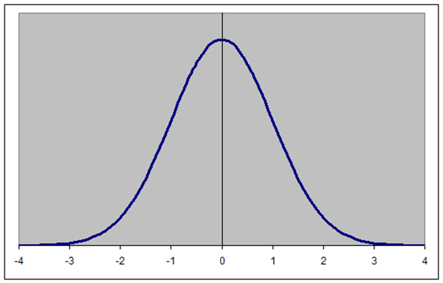
Standardization
Standardizing a test involves administering the test to a representative sample of future test takers in order to establish a basis for meaningful comparison.
Establishes a normal distribution of scores on a tested population — a bell-shaped pattern called the normal curve.
34-14-2
“Normal” = “100”
Each standard deviation is 15
Notes:
OBJECTIVE 32-3| Discuss the importance of standardizing psychological tests, and describe the distribution of scores in a normal curve.

Slide 31
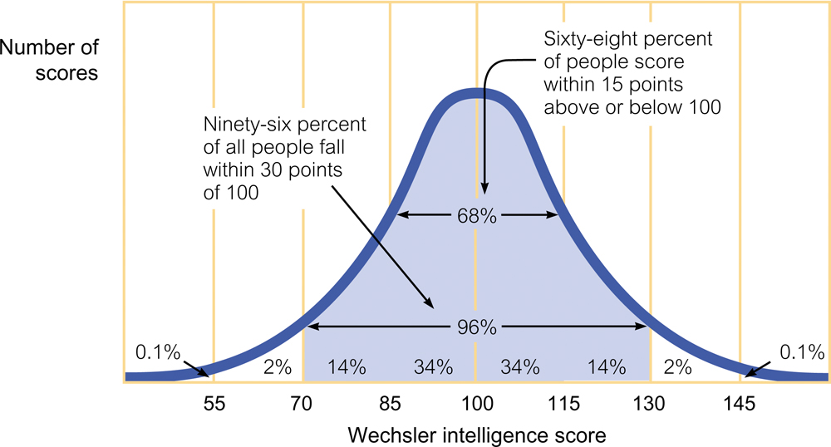

Slide 32
Flynn Effect
Restandardization required. In the past 60 years intelligence scores have steadily risen by an average of 27 points — a phenomenon known as the Flynn Effect.

Slide 33
Reliability
A test is reliable when it yields consistent results. To establish reliability researchers establish different procedures:
Split-half Reliability: Dividing the test into two equal halves and assessing how consistent the scores are.
Reliability using different tests: Using different forms of the test to measure consistency between them.
Test-Retest Reliability: Using the same test on two occasions to measure consistency.
Notes:
OBJECTIVE 32-4| Explain what it means to say that a test is reliable.

Slide 34
Validity
Reliability of a test does not insure validity. Validity of a test refers to what the test is supposed to measure or predict.
Content Validity: Refers to the extent a test measures a particular behavior or trait. (Achievement tests)
Predictive Validity: Refers to the function of a test in predicting a particular behavior or trait. (Aptitude tests)
Criterion Validity: Do the results correlate with the results of other measures designed to assess similar things
Notes:
OBJECTIVE 32-5| Explain what it means to say that a test is valid, and describe two types of validity.

Slide 35
Aptitude and Achievement Tests
Aptitude tests are intended to predict your ability to learn a new skill and achievement tests are intended to reflect what you have already learned.
Notes:
OBJECTIVE 32-2| Distinguish between aptitude and achievement tests, and describe the modern test of mental abilities, such as the WAIS.

Slide 36
Limitations of Intelligence Tests
Intelligence can’t be measured directly
Can we even define it?
Tests only measure a sampling of factors
Doesn’t measure street smarts
Scores can change with experience and training
Why people take ACT prep classes
What kinds of life experiences have you had?

Slide 37
Predictors of Success Inventory
Research shows that your attitude (grit, EQ, character,…) is a better predictor of your success than your IQ.
How has Lindbergh fostered this success?
You will be creating a survey that sets out to identify areas of strength and weakness regarding preparing students for success using these indicators.
Operationally define success for your survey takers.
Create survey questions that address the following topics:
Grit
Emotional Intelligence
Character (responsibility, respect, caring,…)
Creativity
Growth Mindset (basic abilities can be developed through dedication and hard work)
Notes:
When it comes to success, it’s easy to think that people blessed with brains are inevitably going to leave the rest of us in the dust. But new research challenges that notion.

Slide 38
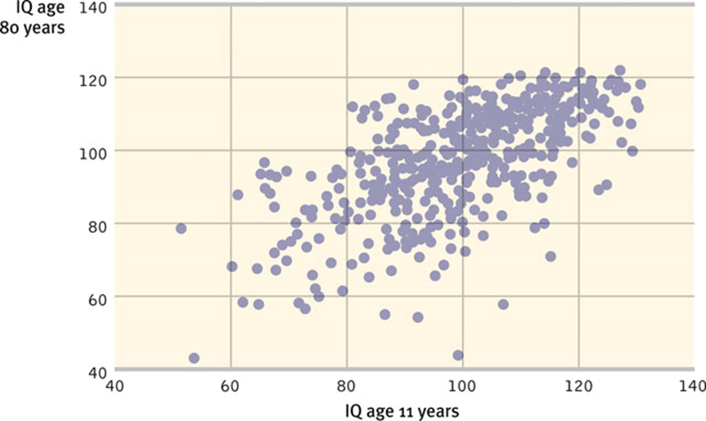
The Dynamics of Intelligence
Does intelligence stay stable over a lifetime or change?
Intelligence scores become stable after about seven years of age.

Slide 39
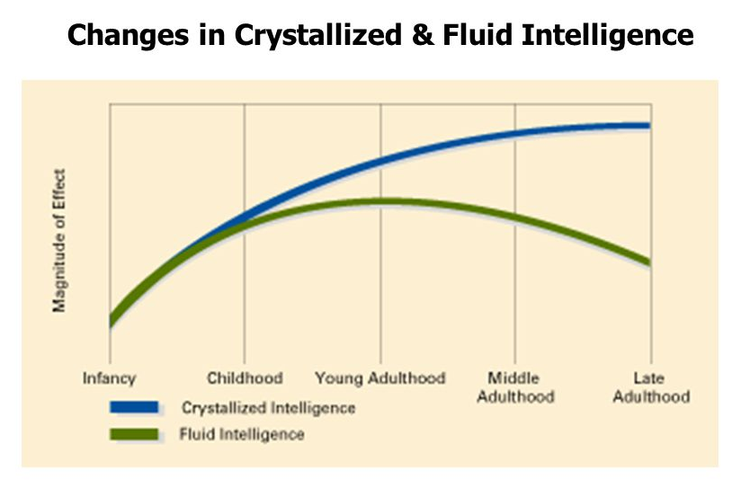
Stability or Change?
Crystallized Intelligence represents facts and past experiences (does not decline with age)
Fluid intelligence represents the ability to learn new procedures, behaviors (does decline with age)

Slide 40
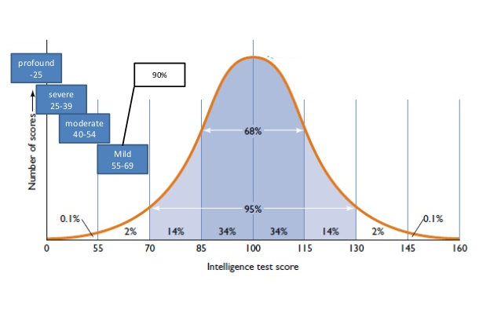
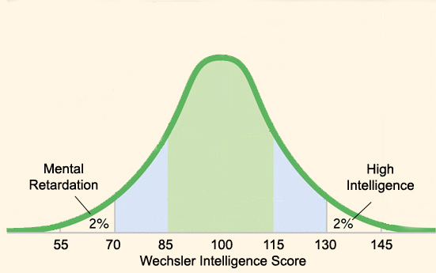
Extremes of Intelligence
A valid intelligence test divides two groups of people into two extremes. The intellectually disabled (IQ 70) and individuals with high intelligence (IQ 130) are significantly different.
Notes:
OBJECTIVE 36-7| Discuss the two extremes of the normal distribution of intelligence.

Slide 41
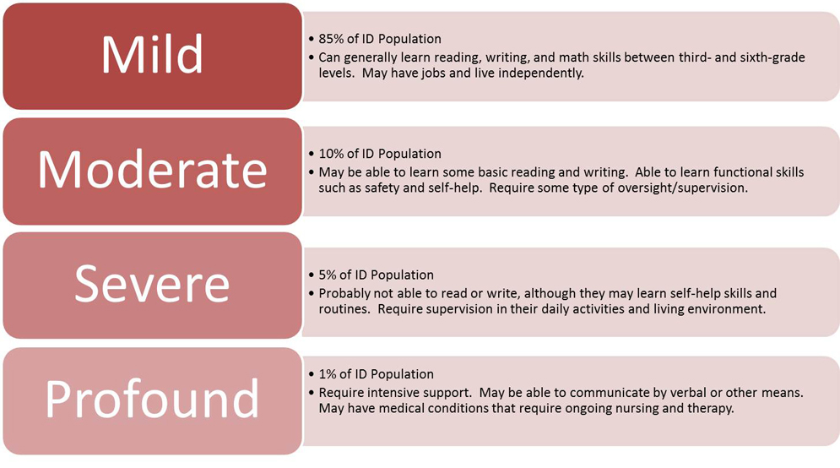
Intellectual Disability
Individuals who required constant supervision a few decades ago, but with supportive family environment and special education can now care for themselves.
Notes:
Mild intellectual disability
IQ 50 to 70
Slower than typical in all developmental areas
No unusual physical characteristics
Able to learn practical life skills
Attains reading and math skills up to grade levels 3 to 6
Able to blend in socially
Functions in daily life
About 85 percent of people with intellectual disabilities fall into the mild category and many even achieve academic success. A person who can read, but has difficulty comprehending what he or she reads represents one example of someone with mild intellectual disability.
Moderate intellectual disability
IQ 35 to 49
Noticeable developmental delays (i.e. speech, motor skills)
May have physical signs of impairment (i.e. thick tongue)
Can communicate in basic, simple ways
Able to learn basic health and safety skills
Can complete self-care activities
Can travel alone to nearby, familiar places
People with moderate intellectual disability have fair communication skills, but cannot typically communicate on complex levels. They may have difficulty in social situations and problems with social cues and judgment. These people can care for themselves, but might need more instruction and support than the typical person. Many can live in independent situations, but some still need the support of a group home. About 10 percent of those with intellectual disabilities fall into the moderate category.
Severe intellectual disability
IQ 20 to 34
Considerable delays in development
Understands speech, but little ability to communicate
Able to learn daily routines
May learn very simple self-care
Needs direct supervision in social situations
Only about 3 or 4 percent of those diagnosed with intellectual disability fall into the severe category. These people can only communicate on the most basic levels. They cannot perform all self-care activities independently and need daily supervision and support. Most people in this category cannot successfully live an independent life and will need to live in a group home setting.
Profound intellectual disability
IQ less than 20
Significant developmental delays in all areas
Obvious physical and congenital abnormalities
Requires close supervision
Requires attendant to help in self-care activities
May respond to physical and social activities
Not capable of independent living
People with profound intellectual disability require round-the-clock support and care. They depend on others for all aspects of day-to-day life and have extremely limited communication ability. Frequently, people in this category have other physical limitations as well. About 1 to 2 percent of people with intellectual disabilities fall into this category.
According to the new DSM-V, though, someone with severe social impairment (so severe they would fall into the moderate category, for example) may be placed in the mild category because they have an IQ of 80 or 85. So the changes in the DSM-V require mental health professionals to assess the level of impairment by weighing the IQ score against the person's ability to perform day-to-day life skills and activities.

Slide 42
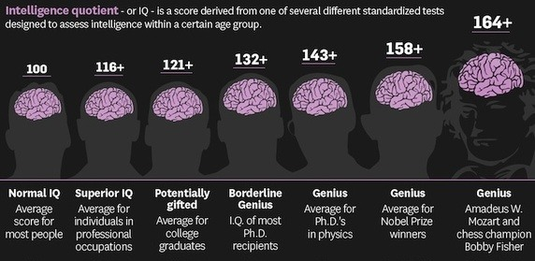
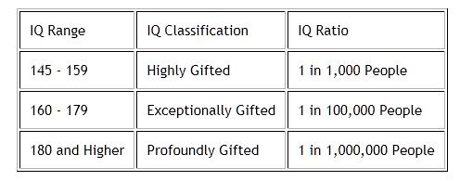
High Intelligence
High-scoring people on intelligence tests—contrary to popular beliefs—tend to be healthy, well adjusted, and unusually successful academically.

Slide 43
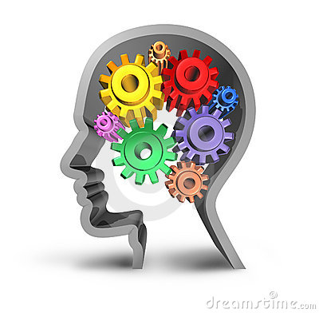
Influences on Intelligence
Genetic Influences
Kinship Studies
Heritability – extent to which variations in a trait are genetic
50% - 70%
Adoptee Studies
Scores more similar to biological parents than adoptive
Environmental Studies
Home and Parenting
Emotionally and verbally responsive
Educational toys
Involved in activities
Varied experiences
Well-organized home
Pre-school Programs
Enriched early experiences
Head Start
Increased IQ scores, positive long-term effects
Adults and Intelligence
Drop-off in intelligence
Timed tests
Biological changes
Environment is strong factor - Seattle Study

Slide 44
AP info…
G factor (Spearman) general intelligence
Multiple Intelligences (9-Gardner)
Emotional Intelligence (Mayer, Salvoley)
Triarchic theory of intelligence (Sternberg)
creative, practical, analytical
Flynn Effect—IQ increases
Alfred Binet dev first skill sets which were adapted into IQ tests
Adapted into Stanford-Binet by Terman

Slide 45
More AP info…
KNOW THE NORMAL CURVE for WAIS
Can you calculate an IQ (MA/CA)*100
Crystallized and fluid intelligence
Content validity (achievement), predictive validity
(aptitude)

