Slide 1
Shaping & Chaining
Skinner
Reinforcers are used with successive approximations towards the desired behavior
https://www.youtube.com/watch?v=6oFO9Z0oHBA
Ex: want dog to roll over
Step 1 – “Down” =treat
Step 2 - Down & roll on back = treat
Step 3 – down, roll on back, back up the other side = treat

Slide 2
Discrimination
A discriminative stimulus – one that signals to the organism that a response will be reinforced
http://digitaljournal.com/article/317885

Slide 3
Reinforcer – any consequence that strengthens behavior

Slide 4
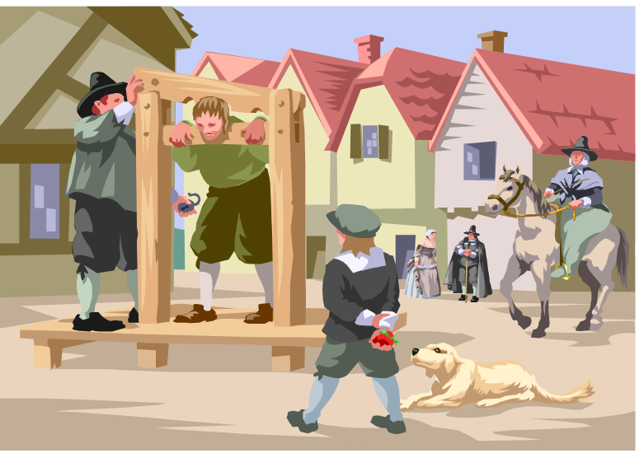
Punishment: any consequence that decreases a behavior

Slide 5
Punishment tells you what not to do, Reinforcement tells you what to do!
Punished behavior is suppressed, not forgotten
Punishment teaches discrimination re: when you can get away with the behavior
Punishment can teach fear
Physical punishment may teach aggressive behavior by modeling aggression as a way to cope with problems

Slide 6
Primary reinforcers
Satisfy a basic / biological need
Unlearned & innately satisfying
Ex: water when thirsty, relief from pain, hug when needing security or belonging

Slide 7
Secondary reinforcers
AKA Conditioned reinforcers
Learned by association with primary reinforcers
Ex: work hard → more money → food / shelter

Slide 8
Immediate and Delayed reinforcers
Immediate reinforcers are powerful, but humans have the ability to learn from delayed reinforcement.
A greater the ability to delay gratification often correlates in surveys with a higher standard of living later in life.
https://www.youtube.com/watch?v=Yo4WF3cSd9Q

Slide 9
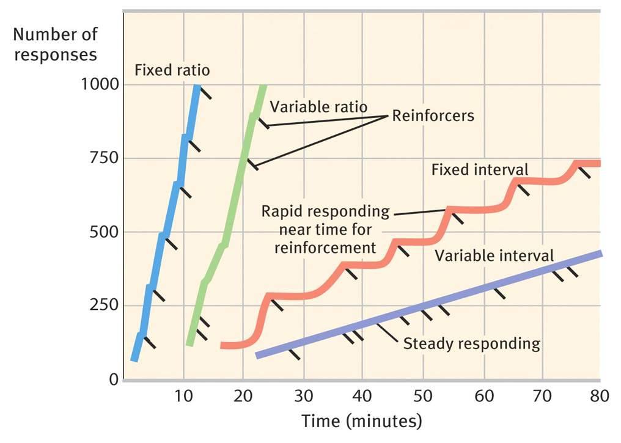
Fixed-ratio schedules | Rewards after a fixed # of responses
Variable-ratio | Rewards after an unpredictable # of responses
Fixed-interval | Rewards after a fixed time period
Variable-interval | Rewards after a variable time period

Slide 10
What kind of schedule?
1. A senior citizen buying state lottery tickets and winning.
2. A hotel maid may take a 15-minute break only after having cleaned three rooms.
3. A man watches and sees shooting stars on a dark night.
4. A teenager receives an allowance every Saturday.
5. A woman checks the front porch for a newspaper when the delivery person is extremely unpredictable.
6. A professional baseball player gets a hit approximately every third time at bat.
7. A baker checks the oven to see if chocolate chip cookies are done, when the suggested baking time is up.
8. A blueberry picker receives $1 after filling 3 pint boxes.
9. A charitable organization makes an average of 10 phone calls for every donation it receives.
10. A busy executive calls a garage mechanic to see if her car is fixed yet.

Slide 11
Other Conditioning issues
Overjustification effect
Shaping and Chaining
Token economies – behavior modification

Slide 12
Skinner’s Legacy
argued that behaviors were shaped by external influences instead of inner thoughts and feelings
Critics argued that Skinner dehumanized people by neglecting their free will.
Falk/ Photo Researchers, Inc.
Notes:
OBJECTIVE 18| Describe the controversy over Skinner’s views of human behavior.

Slide 13
Classical vs. Operant Conditioning
Mike and Laura’s pet dachshund, Greta, loved to play fetch. While playing fetch one afternoon with a tennis ball, she accidently picked up the ball after it had, landed in a fire ant hill. Needless to say, Greta’s mouth got many painful bites. From that point on, Greta avoided any ball that was the same size as a tennis ball or smaller.
How would Pavlov and Skinner each have explained this outcome? Use the key terminology for each (example UCS / reinforcement etc)

Slide 14
Latent Learning
Learning that occurs but isn’t apparent until there is an incentive to demonstrate it
Evidence of cognition (mental activity associated with thinking, knowing and remembering)
Cognitive map – mental representation of a layout of one’s environment

Slide 15
Insight
A sudden, novel realization of the answer to a problem

Slide 16
Motivation
Intrinsic – inward desire to behave a certain way, this can be damaged by overuse of rewards (Overjustification effect)
Extrinsic – desire to behave a certain way to receive a reward or avoid a punishment

Slide 17
Social Learning Theory
Bandura

Slide 18
Key terms & issues
Social modeling
Bandura – Social Learning theory – 1977 (bobo)
Mirror neurons – Rizzolatti (1991)
Pro-social behavior
Anti-social behavior

Slide 19
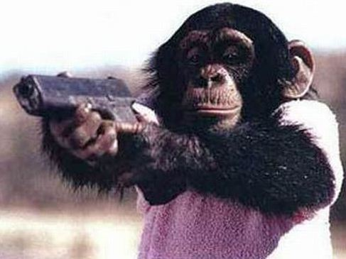

Slide 20
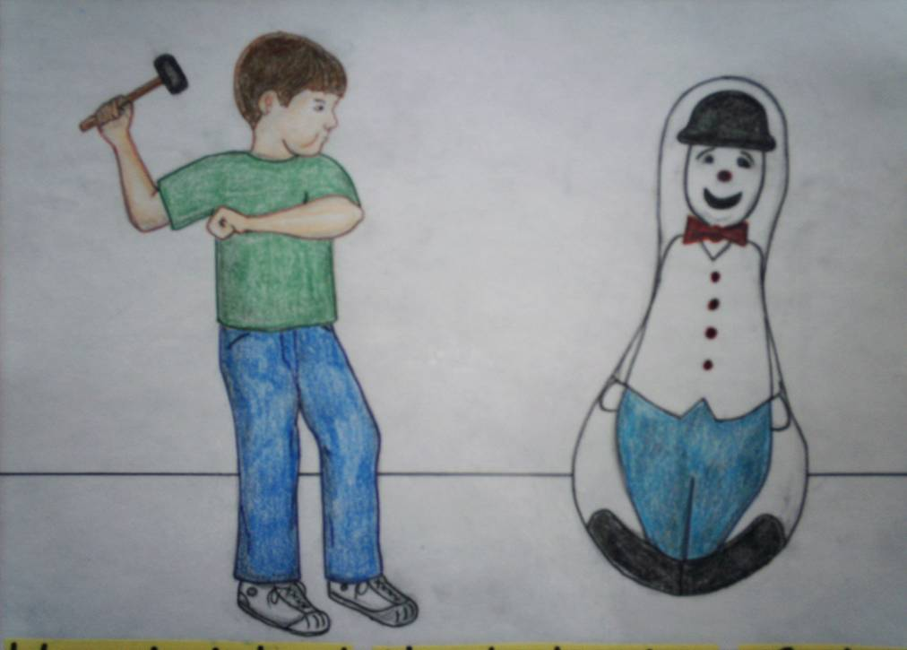
The bobo doll experiment!

Slide 21
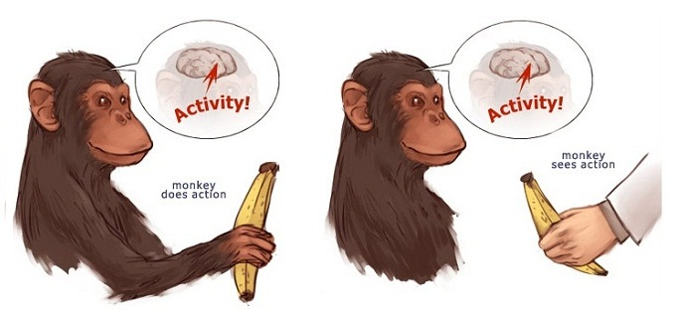

Slide 22
Mirror Neurons
http://www.pbs.org/wgbh/nova/body/mirror-neurons.html

Slide 24
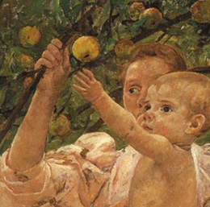

Slide 26
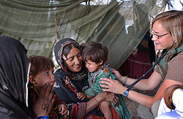

Slide 27
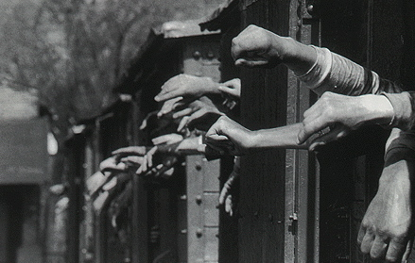

Slide 28
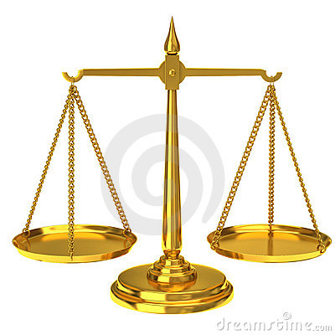
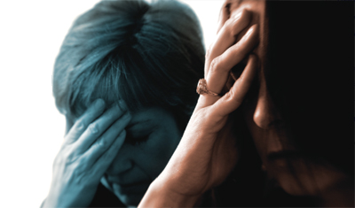
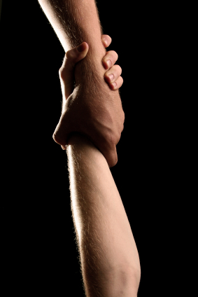

Slide 29
Unilever
Beauty Pressure (Media effect)
Lies by the media

Slide 30
Latent Learning – the lessons we don’t even realize we’ve learned until we have use of them. Evidence of Cognitive learning - not just conditioned learning
Consider the latent impacts of media on body image in young boys and girls.
Impact of violent media?
Other examples of latent learning…

Slide 31
A student is taught how to perform a special type of addition, but does not demonstrate the knowledge until an important test is administered.
A passenger in a carpool learns the route to work each day through observation, but does not exhibit that knowledge until it is necessary for him to drive the same route.
A child observes others using proper manners but does not demonstrate that knowledge until prompted to use the manners.
An employee is taught how to do specific higher level tasks but does not demonstrate the ability to do them until he is given a promotion.
A college freshman is taught study skills, but does not study until failing several exams. Upon using the skills taught to him, he is successful on exams.
A college student is taught how to teach, but is unable to demonstrate that knowledge until she receives a teaching job.
A child observes how to make peanut butter and jelly sandwiches, but does not do so until given the opportunity to make one himself.
A driver watches tire pressure being measured, but does not exhibit the ability to do so until she needs to check if her tire requires inflation.
A child learns how to dance by watching characters on television, but only demonstrates that knowledge once asked by others.
A person learns to cook by watching cooking shows on television, but exhibits the knowledge later, when asked to make a dish for a work event.
A child learns to sew by watching her mother, but does not sew until she loses a button on her own shirt.

Slide 32
Cognitive Approach
Cognitive = “knowledge based” approach to learning (beyond behaviorists)
For instance:
What can we learn from the story of little red riding hood?
If little Albert knew that Watson was banging the metal bars behind him how might that change his response?
Can I develop a fear of heights even if it hasn’t been conditioned?
Cognitive psychologists contend that our internal mental processes play a larger role in learning and behavior than Skinner or Watson recognized.

Slide 33
Cognitive Maps
Make an x on your location and draw the route to your house.
Humans are able to create an internal map of their locations.
http://www.pbs.org/wgbh/nova/nature/waggle-dance.html

